Slide 1
Revision Digital Communication and Signal Processing
Ruohan Zhang
Ruohan.Zhang.1@warwick.ac.uk
Department of Computer Science, University of Warwick
22/05/2024

Slide 2
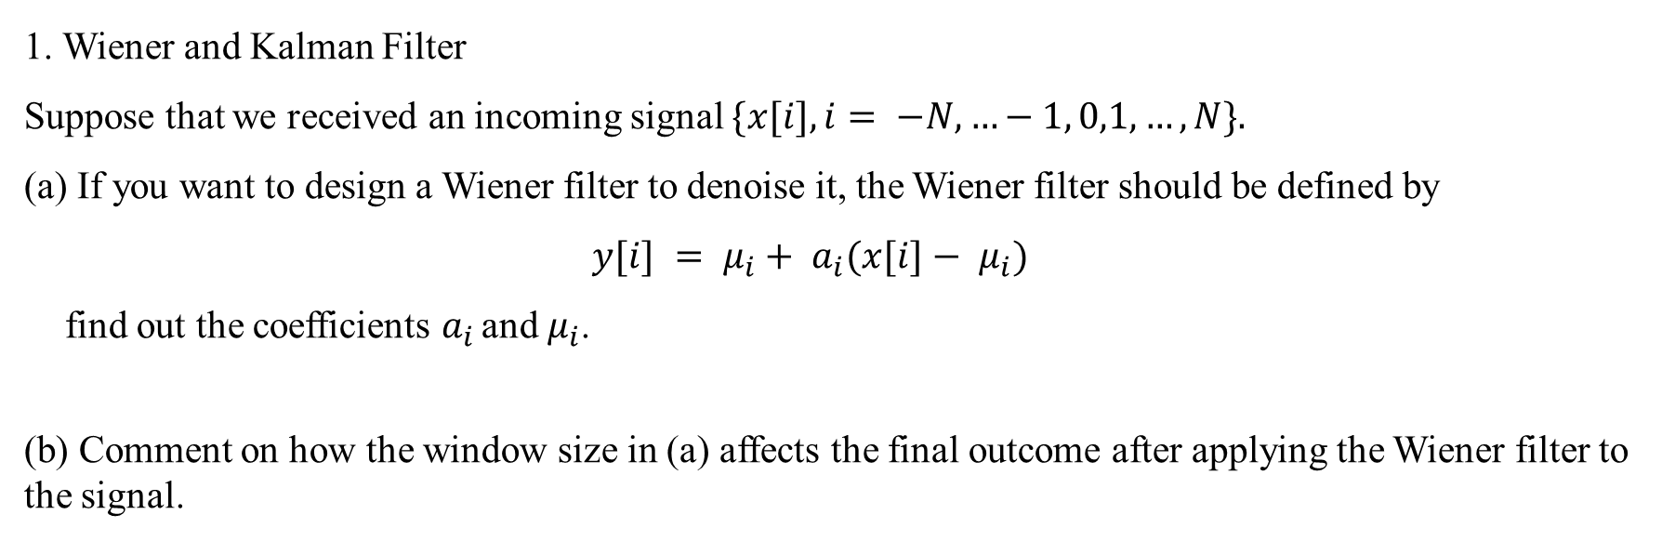
1. Wiener and Kalman Filter
Suppose that we received an incoming signal $\{x[i], i= −N, …−1, 0,1, …,N\}.$
(a) If you want to design a Wiener filter to denoise it, the Wiener filter should be defined by
$$y[i] = μ_{i}+ a_{i}(x[i]− μ_{i})$$
find out the coefficients $a_{i }$and $μ_{i}$.
(b) Comment on how the window size in (a) affects the final outcome after applying the Wiener filter to the signal.

Slide 3
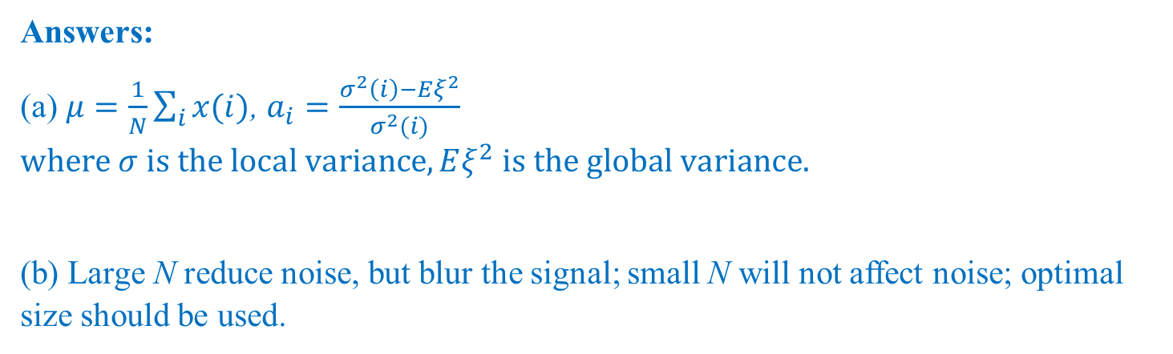
Answers:
(a) $μ=\frac{1}{N}\sum_{i}{x(i)}$, $a_{i}=\frac{σ^{2}\left(i\right)−Eξ^{2}}{σ^{2}(i)}$ $where σ is the local variance, Eξ^{2} is the global variance.$
(b) Large N reduce noise, but blur the signal; small N will not affect noise; optimal size should be used.

Slide 4
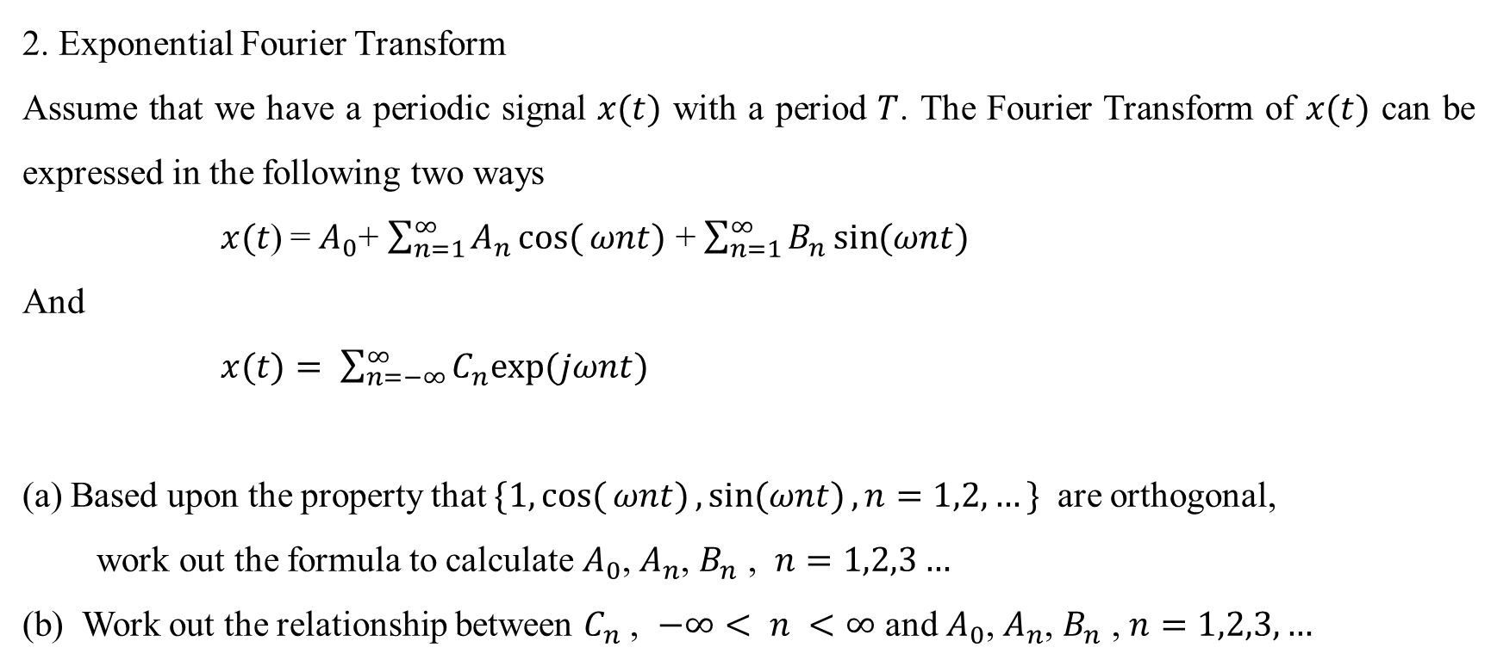
2. Exponential Fourier Transform
Assume that we have a periodic signal $x(t)$ with a period $T$. The Fourier Transform of $x(t)$ can be expressed in the following two ways
$x(t$) =${ A}_{0}$+ $\sum_{n=1}^{∞}{A_{n}cos({ωnt)}}$ + $\sum_{n=1}^{∞}{B_{n}\sin{(ωnt)}}$
And
$x(t)= \sum_{n=−∞}^{∞}{C_{n}exp⁡(jωnt)}$
Based upon the property that $\{1, cos({ωnt)},\sin{(ωnt)}, n=1,2,…\}$ are orthogonal,
work out the formula to calculate $A_{0}$, $A_{n}$, $B_{n}$ , $n=1,2,3…$
(b) Work out the relationship between $C_{n}$ , $−∞< n <∞$ and $A_{0}$, $A_{n}$, $B_{n}$ , $n=1,2,3,…$

Slide 5
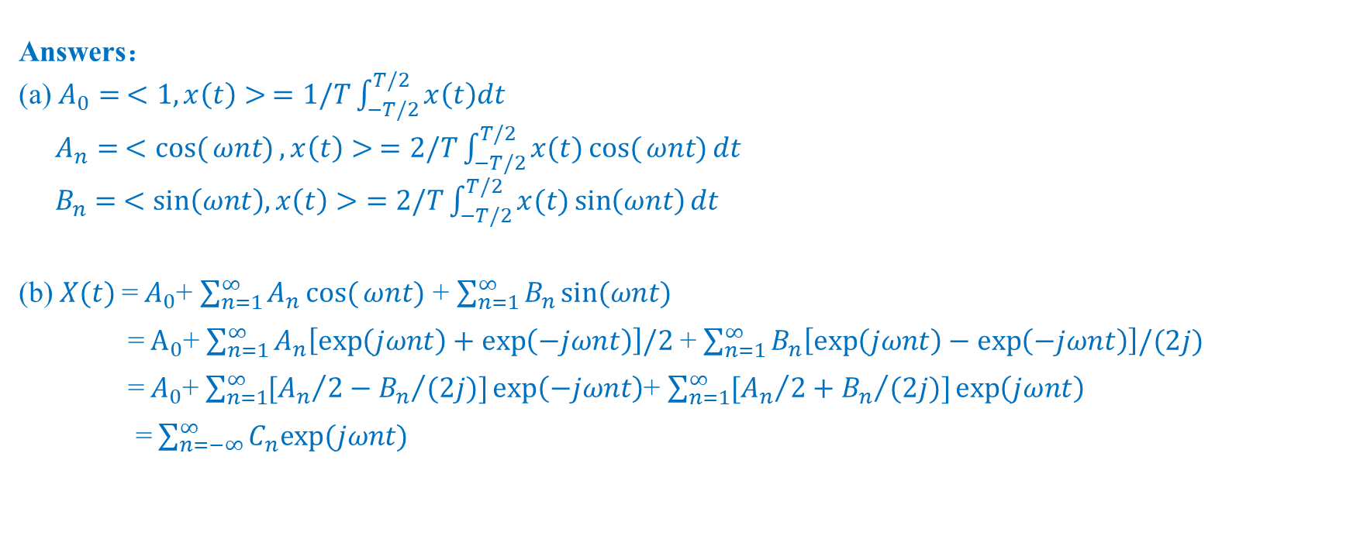
Answers：
(a) $A_{0}= <1,x\left(t\right)> =1/T\int_{−T/2}^{T/2}{x\left(t\right)dt}$
$A_{n}= <cos({ωnt)}, x\left(t\right)> =2/T\int_{−T/2}^{T/2}{x(t)cos({ωnt)}dt}$
$B_{n}= <\sin\left(ωnt\right), x\left(t\right)>=2/T\int_{−T/2}^{T/2}{x(t)\sin\left(ωnt\right)dt}$
(b) $X(t)$=${ A}_{0}$+ $\sum_{n=1}^{∞}{A_{n}cos({ωnt)}}$ + $\sum_{n=1}^{∞}{B_{n}\sin{(ωnt)}}$
=${ A}_{0}$+ $\sum_{n=1}^{∞}{A_{n}\left[\exp\left(jωnt\right)+\exp\left(−jωnt\right)\right]/2}$ + $\sum_{n=1}^{∞}{B_{n}\left[\exp\left(jωnt\right)−\exp\left(−jωnt\right)\right]/(2j)}$
=${ A}_{0}$+ $\sum_{n=1}^{∞}{[{A_{n}}/2−{B_{n}}/{(2j)}]\exp\left(−jωnt\right)}$+ $\sum_{n=1}^{∞}{[{A_{n}}/2+{B_{n}}/{(2j)}]\exp\left(jωnt\right)}$
= $\sum_{n=−∞}^{∞}{C_{n}exp⁡(jωnt)}$

Slide 6
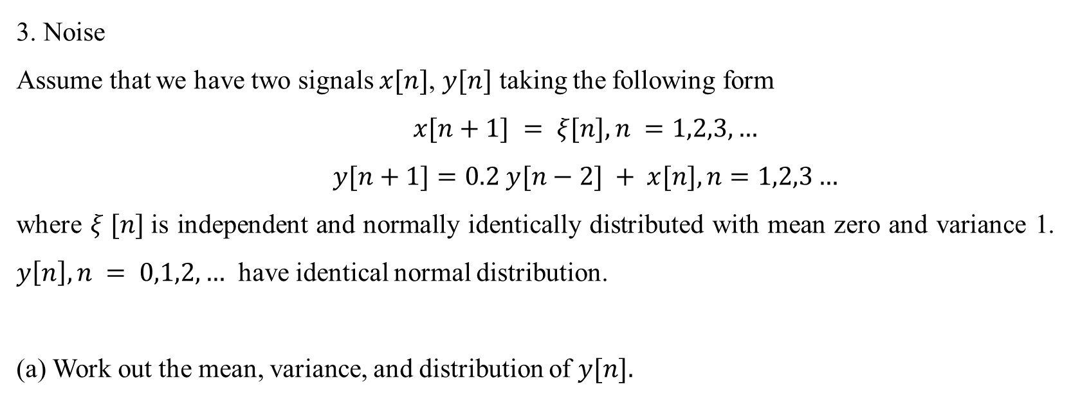
3. Noise
Assume that we have two signals $x[n]$, $y[n]$ taking the following form
$$x[n+1] = ξ[n], n =1,2,3,…$$
$$y[n+1]=0.2 y[n−2] + x[n], n=1,2,3…$$
where $ξ [n]$is independent and normally identically distributed with mean zero and variance 1. $y\left[n\right], n = 0,1,2, …$ have identical normal distribution.
Work out the mean, variance, and distribution of $y[n].$

Slide 7
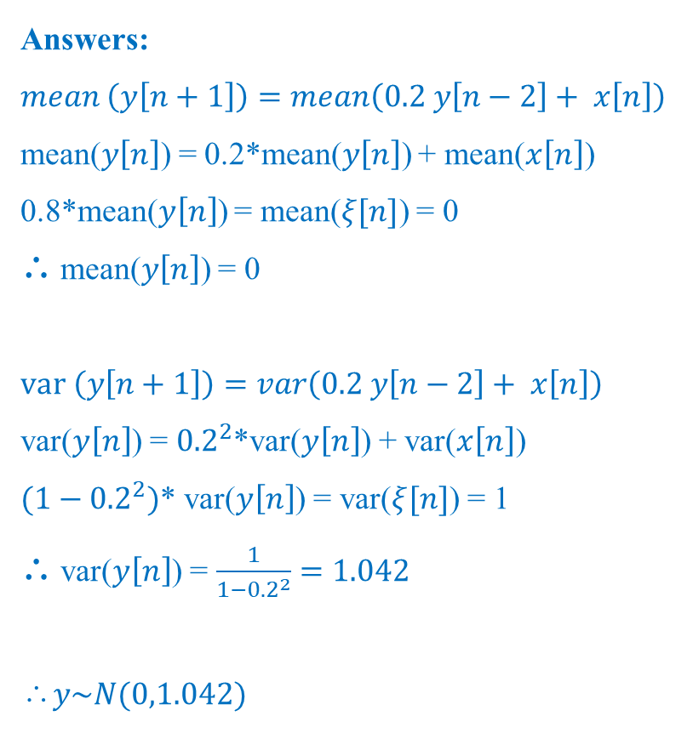
Answers:
$$mean \left(y\left[n+1\right]\right)=mean\left(0.2 y\left[n−2\right]+ x\left[n\right]\right)$$
mean($y\left[n\right]$) = 0.2*mean($y\left[n\right]$) + mean($x\left[n\right]$)
0.8*mean($y\left[n\right]$) = mean($ξ[n]$) = 0
∴ mean($y\left[n\right]$) = 0
$$var \left(y\left[n+1\right]\right)=var\left(0.2 y\left[n−2\right]+ x\left[n\right]\right)$$
var($y\left[n\right]$) = ${0.2}^{2}$*var($y\left[n\right]$) + var($x\left[n\right]$)
${(1−0.2}^{2})$* var($y\left[n\right]$) = var($ξ[n]$) = 1
∴ var($y\left[n\right]$) = $\frac{1}{1−{0.2}^{2}}=1.042$
∴$y\sim N(0,1.042)$

Slide 8
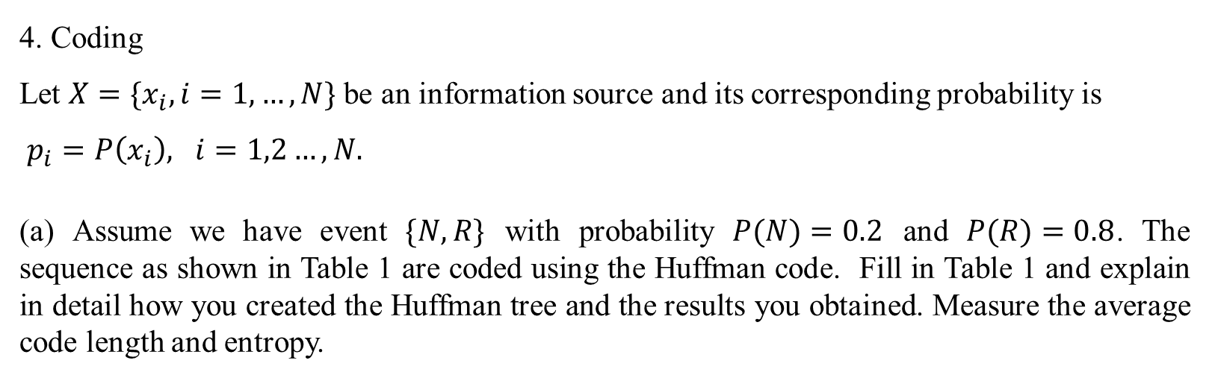
4. Coding
Let $X=\{x_{i}, i=1, …, N\}$ be an information source and its corresponding probability is
$p_{i}=P\left(x_{i}\right), i=1,2…,N.$
(a) Assume we have event $\{N, R\}$ with probability $P(N)=0.2$ and $P(R)=0.8$. The sequence as shown in Table 1 are coded using the Huffman code. Fill in Table 1 and explain in detail how you created the Huffman tree and the results you obtained. Measure the average code length and entropy.
Sequence | NNN | NNR | NRN | RNN | RRN | RNR | NRR | RRR
Probability
Codeword
Codeword Length (in bits)
Weighted code length

Slide 9
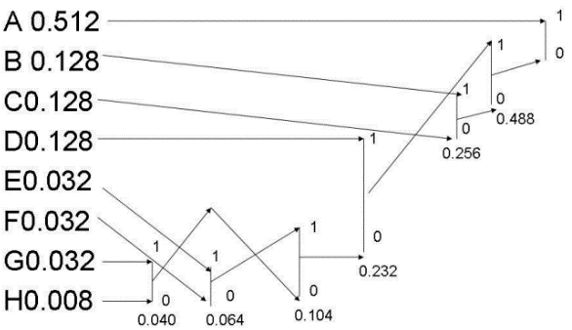
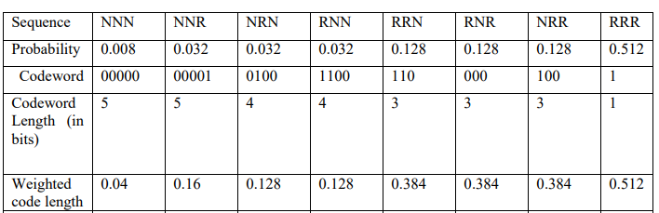
Answers:
The average length is 2.12. The entropy is 2.1658.

Slide 10
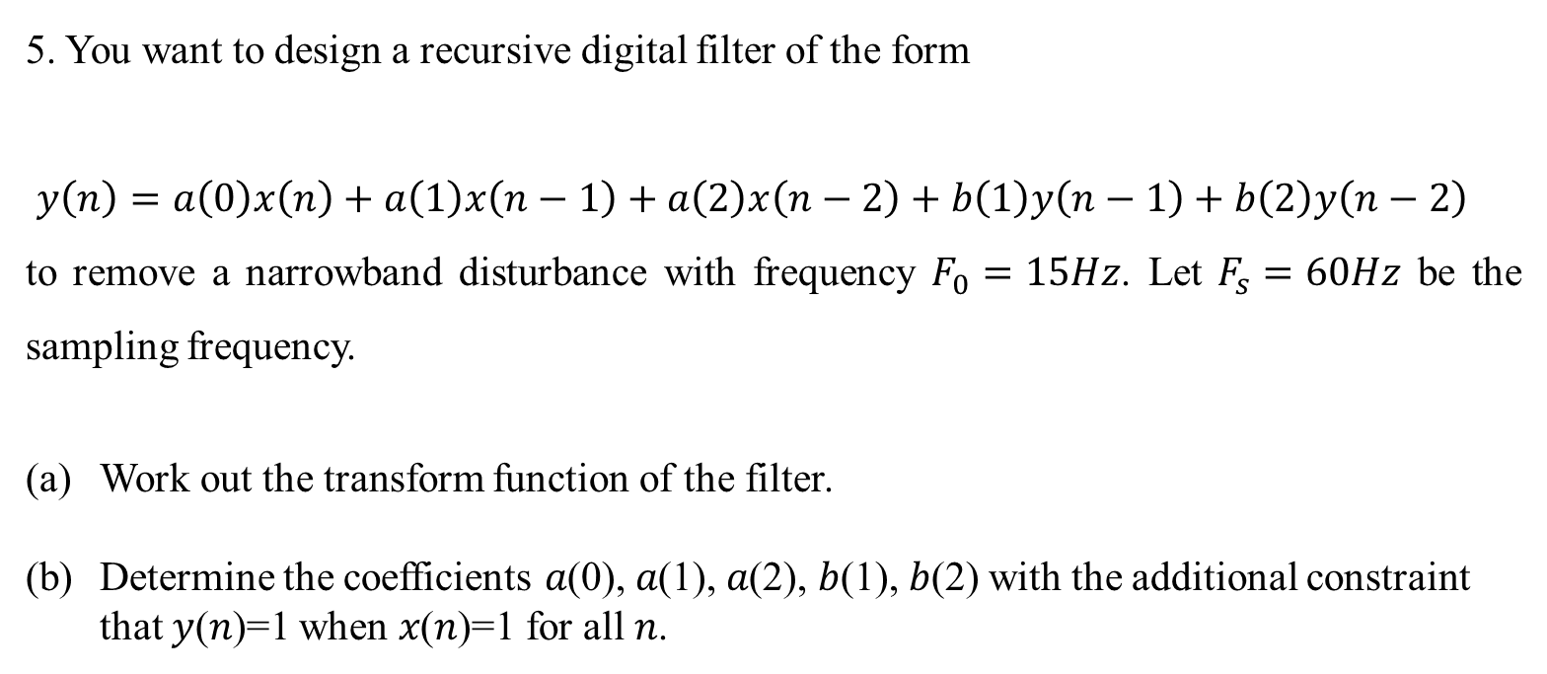
5. You want to design a recursive digital filter of the form
$$y\left(n\right)=a\left(0\right)x\left(n\right)+a\left(1\right)x\left(n−1\right)+a\left(2\right)x\left(n−2\right)+b\left(1\right)y\left(n−1\right)+b\left(2\right)y\left(n−2\right)$$
to remove a narrowband disturbance with frequency $F_{0}=15Hz$. Let $F_{s}=60Hz$ be the sampling frequency.
Work out the transform function of the filter.
Determine the coefficients 𝑎(0), 𝑎(1), 𝑎(2), 𝑏(1), 𝑏(2) with the additional constraint that 𝑦(𝑛)=1 when 𝑥(𝑛)=1 for all 𝑛.

Slide 11
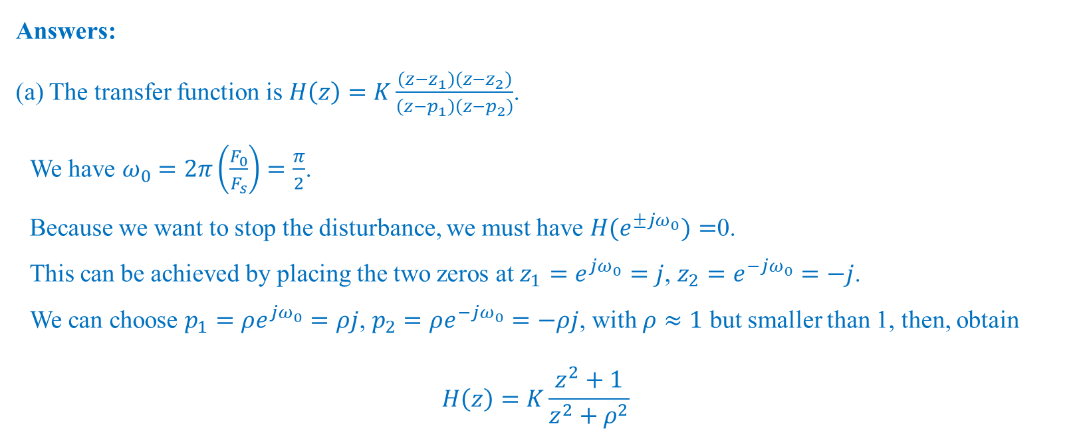
Answers:
(a) The transfer function is $Η\left(z\right)=Κ\frac{\left(z−z_{1}\right)\left(z−z_{2}\right)}{\left(z−p_{1}\right)\left(z−p_{2}\right)}$.
We have $ω_{0}=2π\left(\frac{F_{0}}{F_{s}}\right)=\frac{π}{2}$.
Because we want to stop the disturbance, we must have $H(e^{±jω_{0}})=$0.
This can be achieved by placing the two zeros at ${z_{1}=e}^{jω_{0}}=j$, ${z_{2}=e}^{−jω_{0}}=−j$.
We can choose $p_{1}=ρe^{jω_{0}}=ρj$, $p_{2}=ρe^{−jω_{0}}=−ρj$, with $ρ≈1$ but smaller than 1, then, obtain
$$Η\left(z\right)=Κ\frac{z^{2}+1}{z^{2}+ρ^{2}}$$

Slide 12
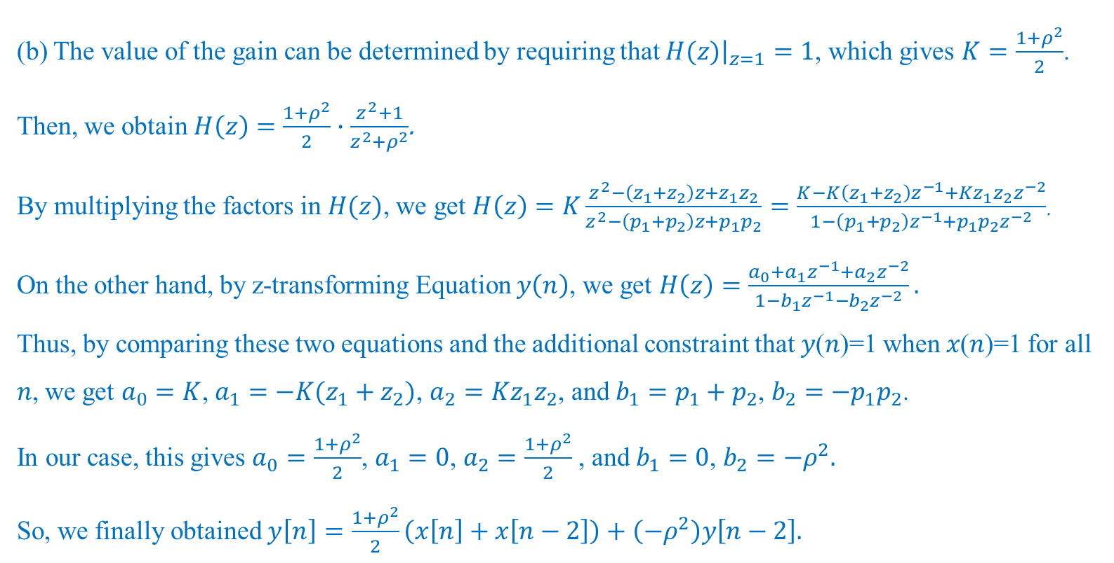
(b) The value of the gain can be determined by requiring that ${\left.H(z)\right|}_{z=1}=1$, which gives $K=\frac{1+ρ^{2}}{2}$. Then, we obtain $Η\left(z\right)=\frac{1+ρ^{2}}{2}∙\frac{z^{2}+1}{z^{2}+ρ^{2}}$.
By multiplying the factors in $H(z)$, we get $Η\left(z\right)=Κ\frac{z^{2}−\left(z_{1}+z_{2}\right)z+z_{1}z_{2}}{z^{2}−\left(p_{1}+p_{2}\right)z+p_{1}p_{2}}$ $=\frac{Κ−Κ\left(z_{1}+z_{2}\right)z^{−1}+Κz_{1}z_{2}z^{−2}}{1−\left(p_{1}+p_{2}\right)z^{−1}+p_{1}p_{2}z^{−2}}$.
On the other hand, by z-transforming Equation $y\left(n\right)$, we get $Η\left(z\right)=\frac{a_{0}+a_{1}z^{−1}+a_{2}z^{−2}}{1−b_{1}z^{−1}−b_{2}z^{−2}}.$
Thus, by comparing these two equations and the additional constraint that 𝑦(𝑛)=1 when 𝑥(𝑛)=1 for all 𝑛, we get $a_{0}=K$, $a_{1}=−K(z_{1}+z_{2})$, $a_{2}=Kz_{1}z_{2}$, and $b_{1}=p_{1}+p_{2}$, $b_{2}={−p}_{1}p_{2}$.
In our case, this gives $a_{0}=\frac{1+ρ^{2}}{2}$, $a_{1}=0$, $a_{2}=\frac{1+ρ^{2}}{2}$, and $b_{1}=0$, $b_{2}=−ρ^{2}.$
So, we finally obtained $y\left[n\right]=\frac{1+ρ^{2}}{2}\left(x\left[n\right]+x\left[n−2\right]\right)+\left(−ρ^{2}\right)y\left[n−2\right].$

Slide 13
Hope all of you can get good marks in the final exam!

